Slide 1

DESIGN THINKING AND INNOVATION
Dr V. Ramakrishna
Professor, Civil Engineering Department
Lakireddy Bali Reddy College of Engineering (A), Mylavaram

Slide 2
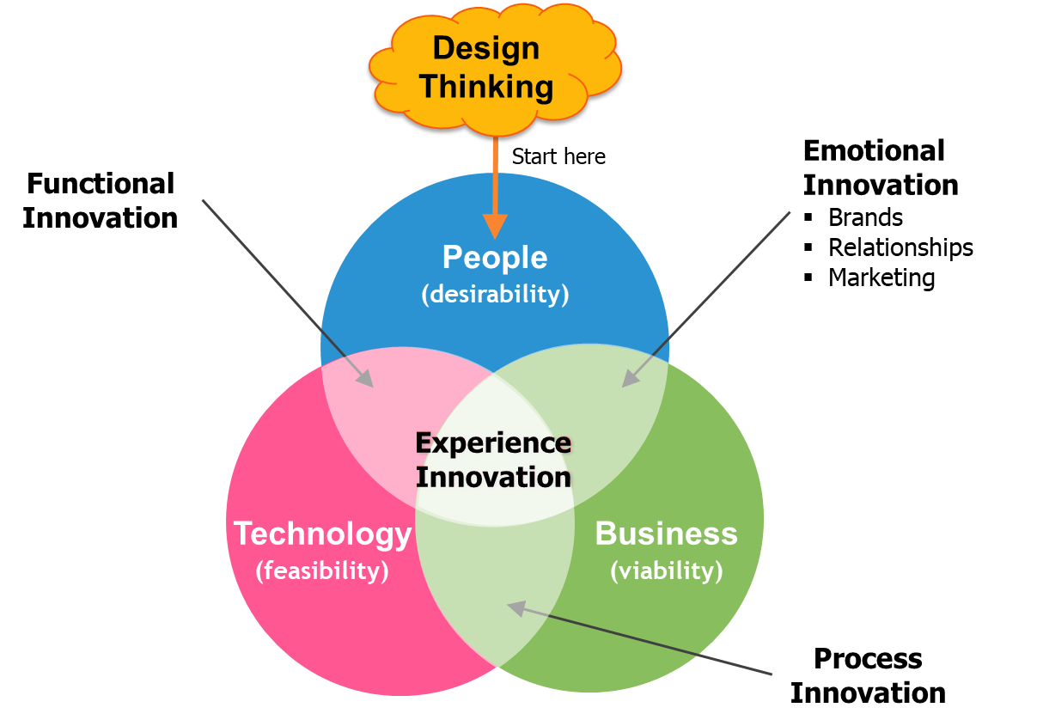
Concept of Design Thinking

Slide 3
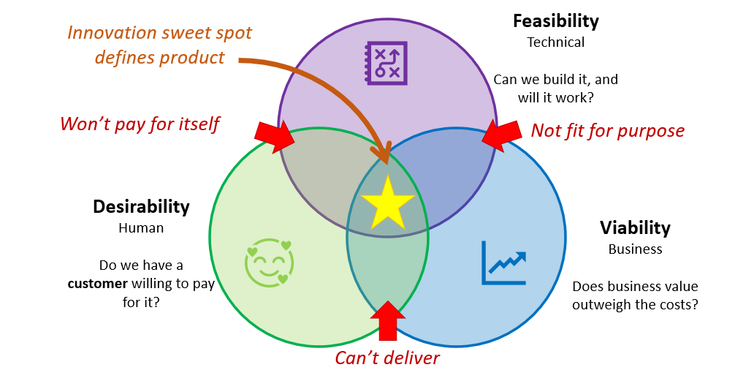
Concept of Design Thinking
Innovation/Outcome

Slide 4
Concept of Design Thinking
Design: Procedure or process to make an item work
Design thinking (DT):
a human-centered approach to problem-solving and innovation
focuses on the needs of people, the possibilities of technology, and the requirements for business success
a non-linear, iterative process
teams use to understand users, challenge assumptions, redefine problems, and create innovative solutions to prototype and test
is a combination of Emotion Quotient (EQ) and Intelligent Quotient (IQ)
promotes team work, Collaboration, Understanding, Creativity, Improvement
Innovation: Improvement over existing model or object or system

Slide 5
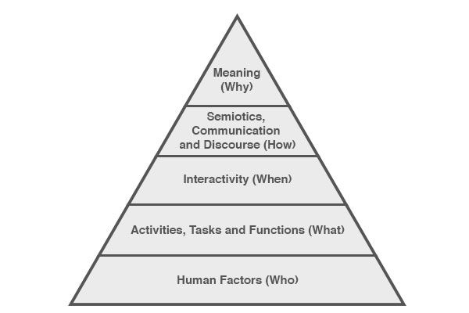
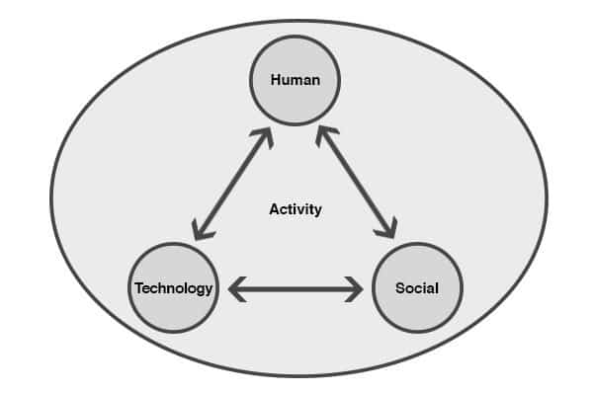
Concept of Design Thinking: Human Centric Approach
Characteristics of Human Centric Approach
Observing the problem
Brain storming
Conceptualization
Developing
Implementing the solution
5 W Concept
Outcome or Product is failure if Human Centric Approach is not focused

Slide 6
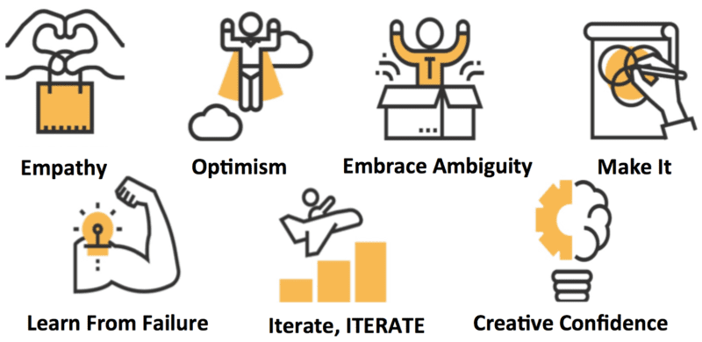

Concept of Design Thinking
Design Thinking Promotes
Empathy
Team work
Adaptability
Improvement
Creativity
Good Atmosphere
Identify Needs of Customer → Develop Product → Refine
Feedback

Slide 7
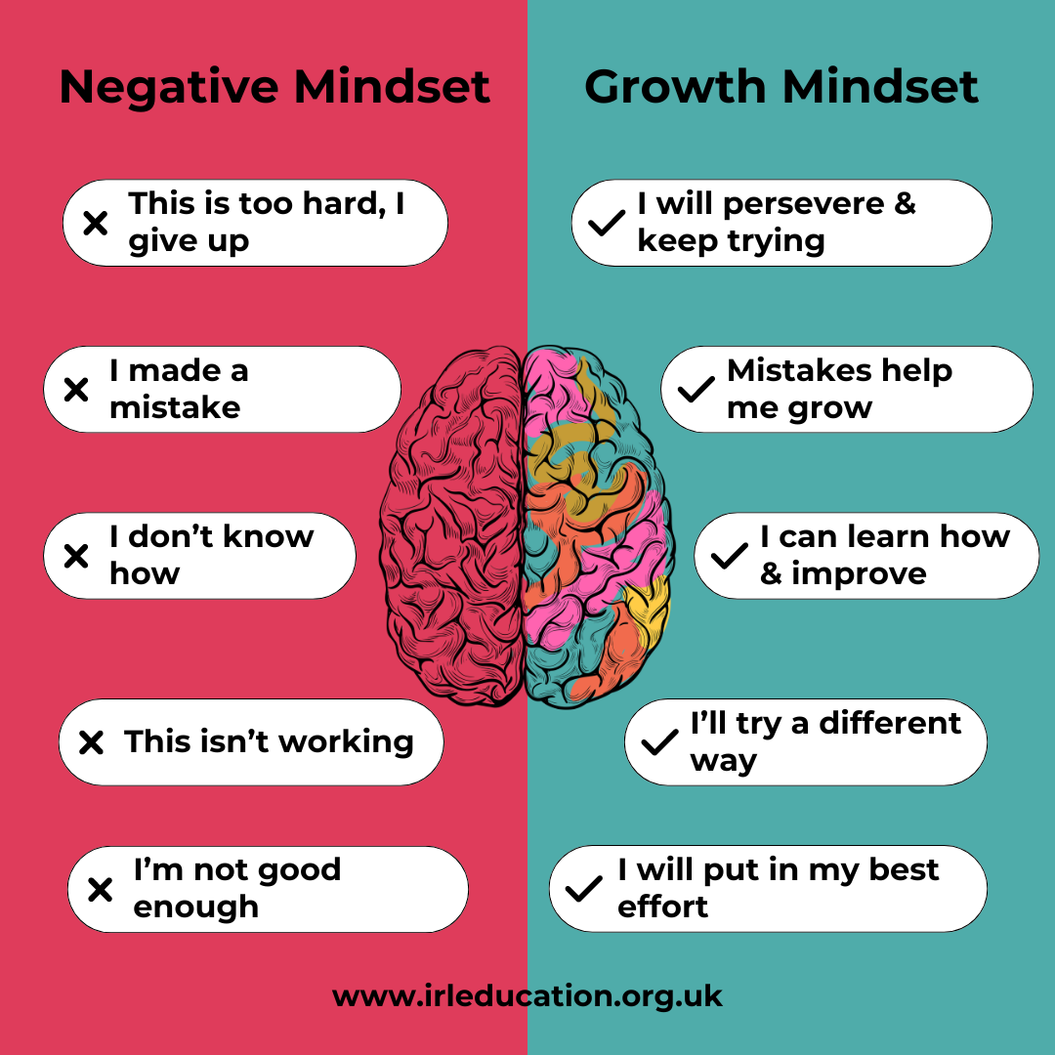
Concept of Design Thinking

Slide 8
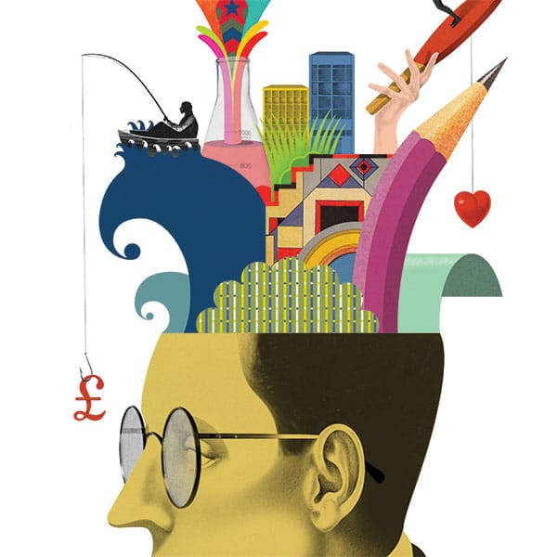
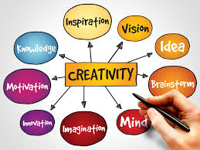

Concept of Design Thinking
Creativity: Different ways of solving same problem or solving with different perceptions
Results in Out of Box thinking
Requires Discussions/Interaction/Team work
Intelligence: Relatively less perspectives

Slide 9
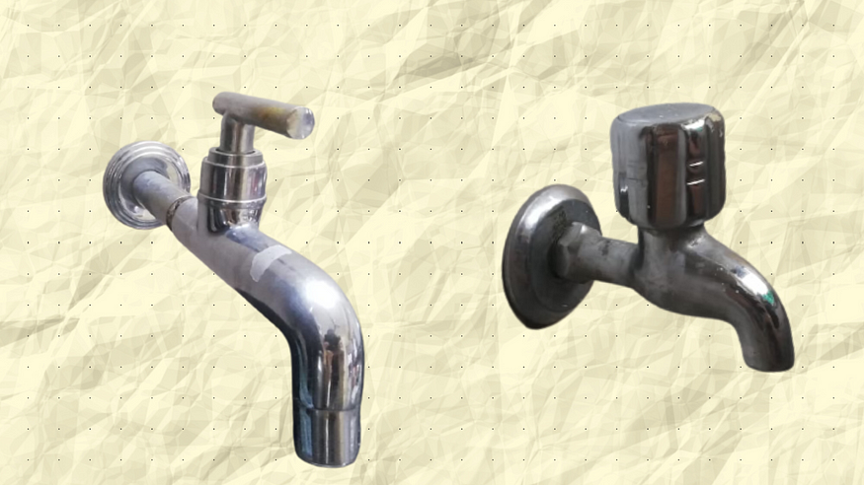
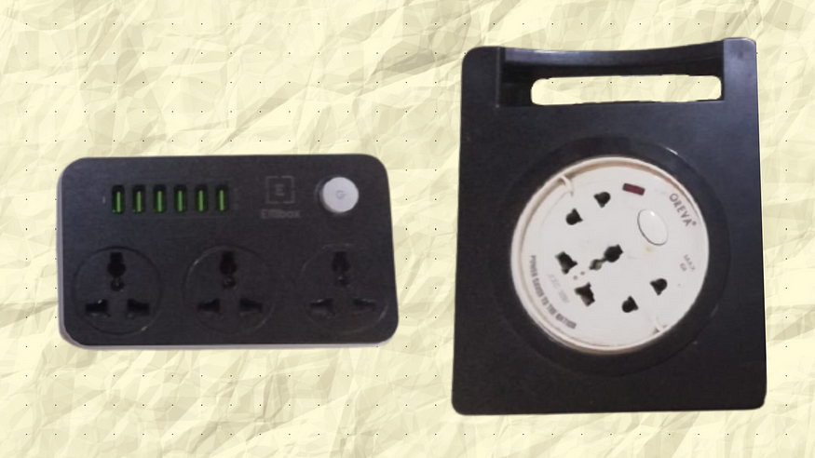
Concept of Design Thinking
Water Taps
Extension Box
GOOD DESIGN OR BAD DESIGN ?????

Slide 10
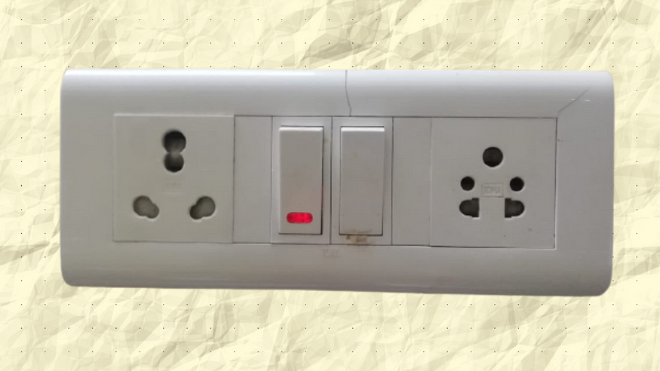
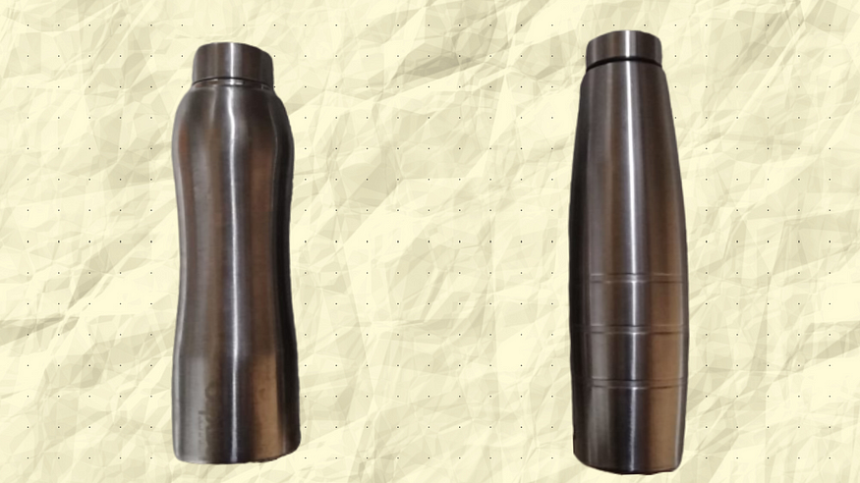
Concept of Design Thinking
Switches
Water Bottle
GOOD DESIGN OR BAD DESIGN ?????

Slide 11

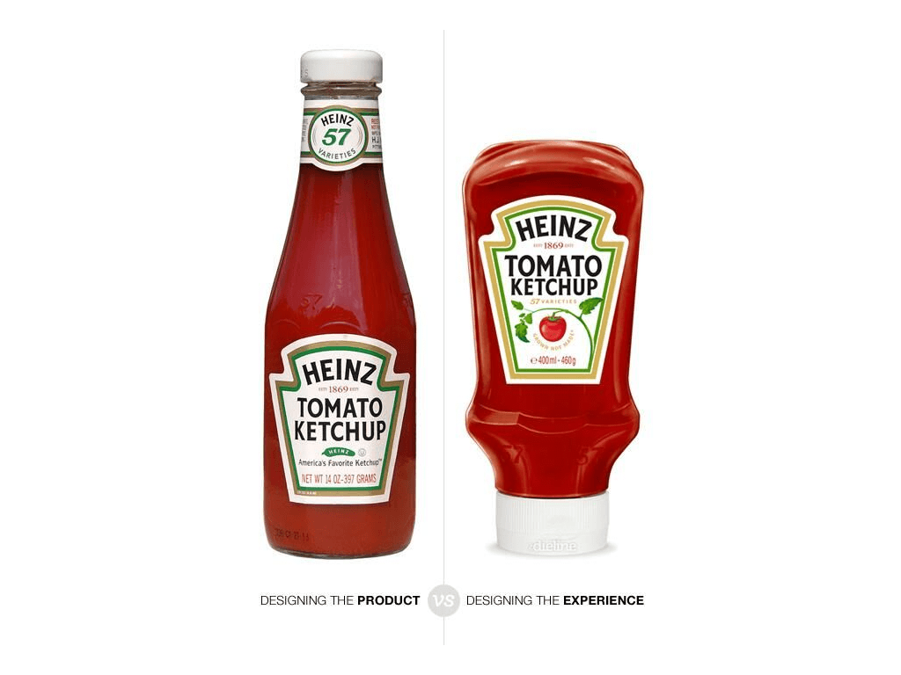
Concept of Design Thinking
Note Book
Sauce/Ketchup Bottle
GOOD DESIGN OR BAD DESIGN ?????

Slide 12
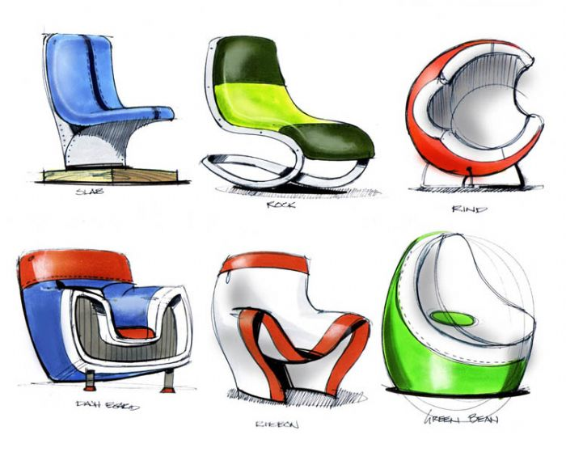
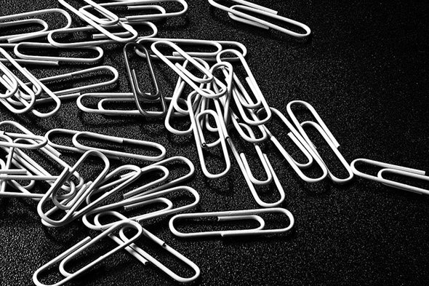
Concept of Design Thinking
Chairs
Paper Clip
GOOD DESIGN OR BAD DESIGN ?????

Slide 13
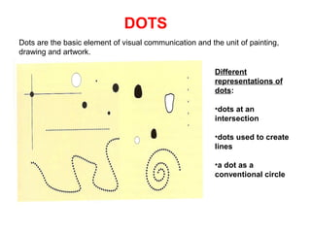
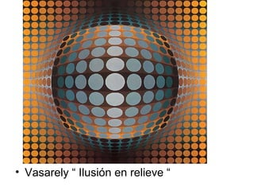
Concept of Design Thinking
DOTS, LINES, PLANES/FORMS: Used as Preliminary tools in developing drawings used as Models for various Design Ideas

Slide 14
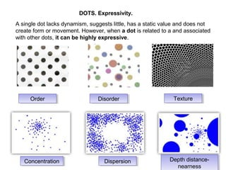
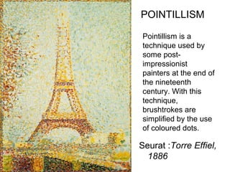
Concept of Design Thinking
DOTS, LINES, PLANES/FORMS: Used as Preliminary tools in developing drawings used as Models for various Design Ideas

Slide 15
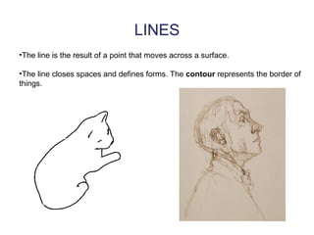
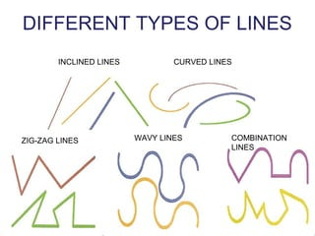
Concept of Design Thinking
DOTS, LINES, PLANES/FORMS: Used as Preliminary tools in developing drawings used as Models for various Design Ideas

Slide 16
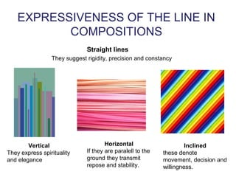
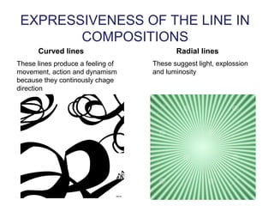
Concept of Design Thinking
DOTS, LINES, PLANES/FORMS: Used as Preliminary tools in developing drawings used as Models for various Design Ideas

Slide 17
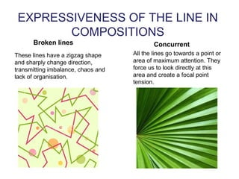
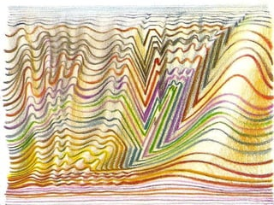
Concept of Design Thinking
Creating Illusion using Lines
DOTS, LINES, PLANES/FORMS: Used as Preliminary tools in developing drawings used as Models for various Design Ideas

Slide 18
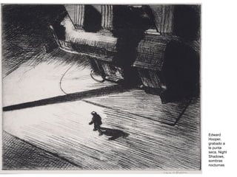
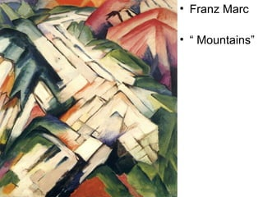
Concept of Design Thinking
Different Outcomes Using Lines
DOTS, LINES, PLANES/FORMS: Used as Preliminary tools in developing drawings used as Models for various Design Ideas

Slide 19
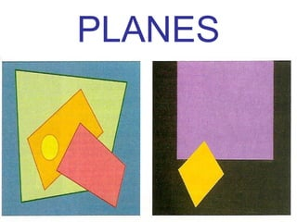
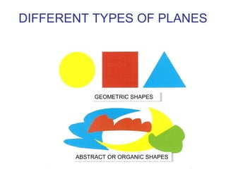
Concept of Design Thinking
DOTS, LINES, PLANES/FORMS: Used as Preliminary tools in developing drawings used as Models for various Design Ideas

Slide 20
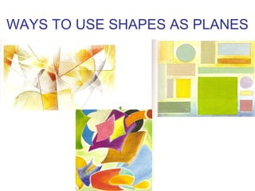
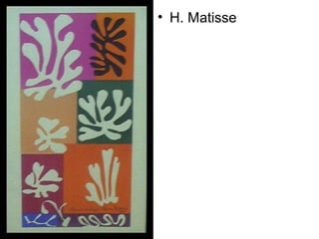
Concept of Design Thinking
DOTS, LINES, PLANES/FORMS: Used as Preliminary tools in developing drawings used as Models for various Design Ideas

Slide 21
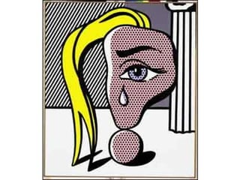
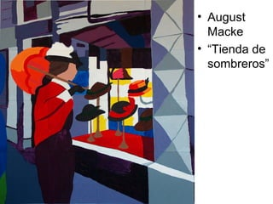
Concept of Design Thinking
DOTS, LINES, PLANES/FORMS: Used as Preliminary tools in developing drawings used as Models for various Design Ideas

Slide 22
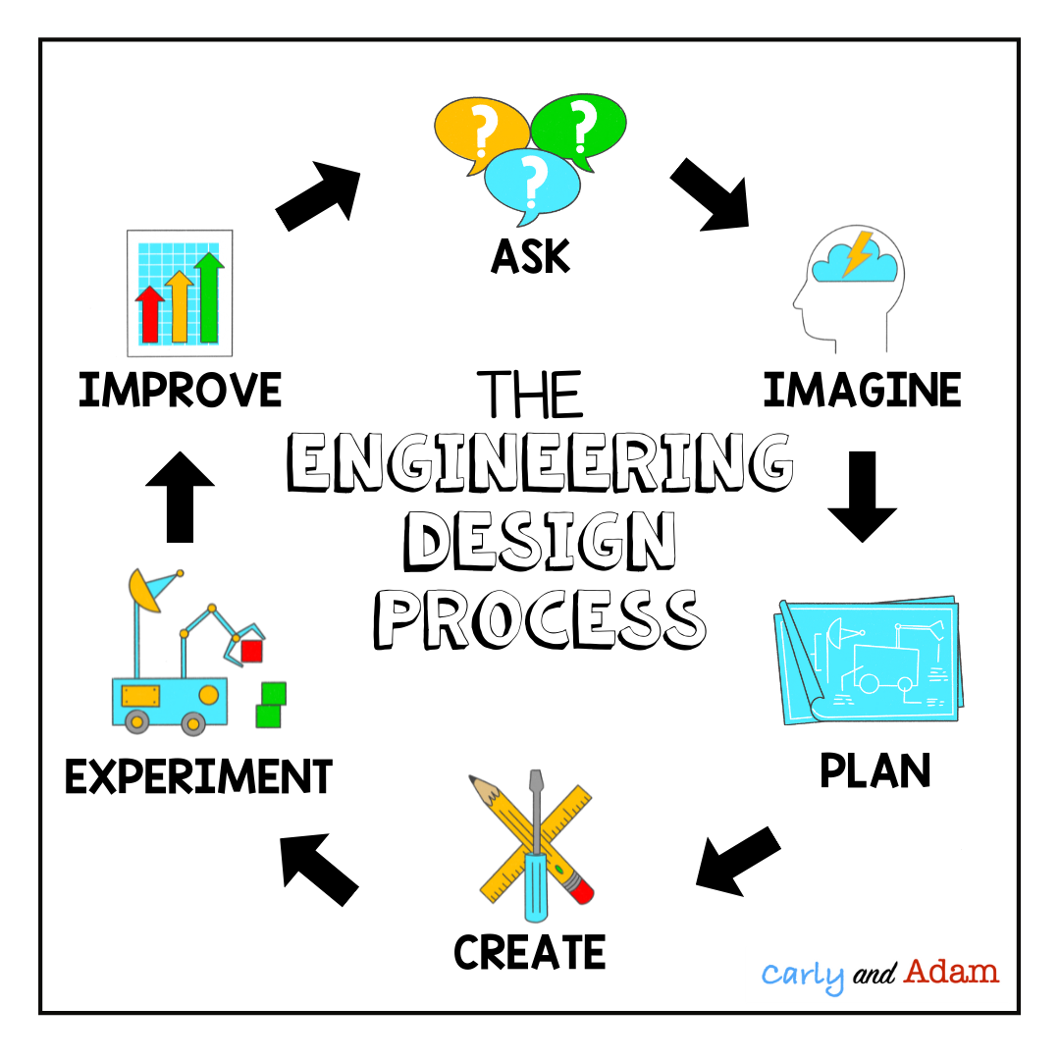
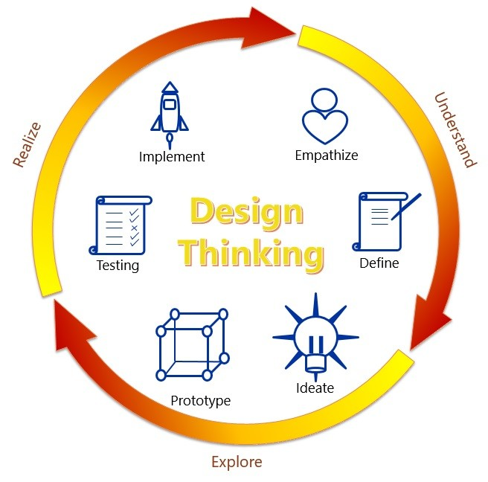
Elements of Design Thinking

Slide 23
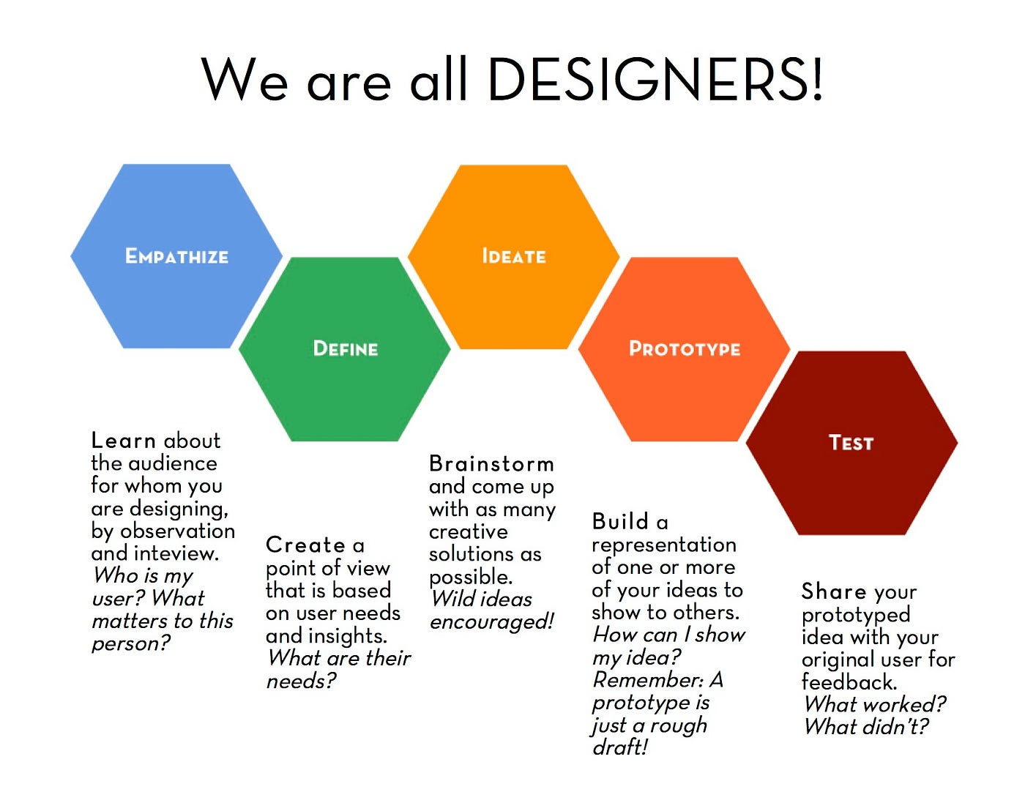
Elements of Design Thinking
INSIGHTS
NEEDS
CONCEPTS
MODELS
REFINE

Slide 24
Concept of Design Thinking
ACTIVITIES
S No | Activity | Work Plan | Observations
1 | Ball game | Throwing ball behind and another person catches it in a basket. Team that catches most balls in given time is the winner. | Team work, Coordination, Flexibility
2 | Passing the bat | Hands of the team members are locked. They pass a bat or object from one person to another without breaking the lock. Team that completes the task in less time is recorded. | Team work, Coordination, Flexibility
3 | Closed hoop game | Hands of the team members are locked. They pass a bat or object from one person to another without breaking the lock. Team that completes the task in less time is recorded. | Team work, Coordination, Flexibility
4 | Dumb Charades | One member is given a name of fruit or an object. He demonstrates through different signs the characteristics of the object without uttering single word. Other person should identify the object from the gestures. | Coordination, Creative expressions, Quick thinking

Slide 25


